Slide 1
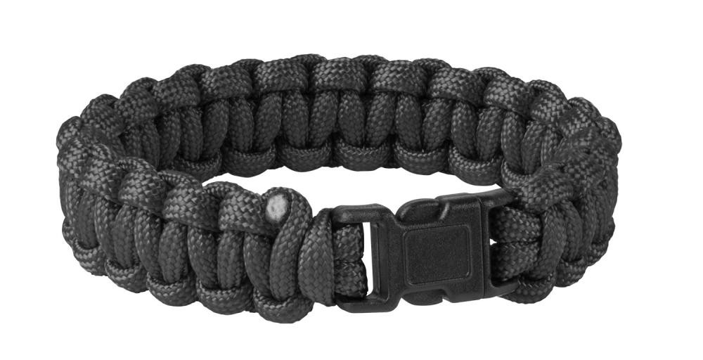
DIY: Paracord Survival Bracelet
Adapted From:
DIY: Paracord Survival Bracelet
Ashley Brown|November 30, 2017

Slide 2
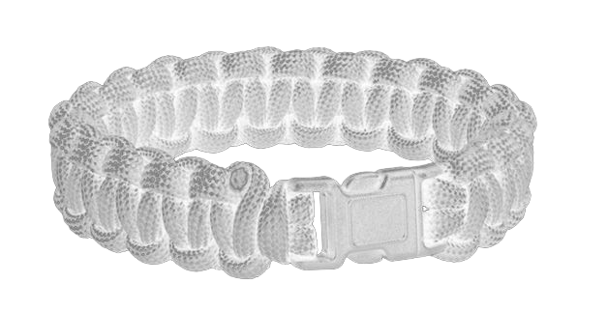
Paracord Survival Bracelet
Paracord is one of the most useful items to have on an adventure.
From replacing a broken shoe string to making a fishing line, it has a wide variety of uses that come in handy in both day-to-day situations and wilderness scenarios.
DIY survival bracelets make great gifts since you can personalize the size and color.
You can even make your four-legged friend a new collar.
This DIY guide will show you how to craft your own bracelet using a cobra weave technique.
Once you’ve got the technique down, use your imagination to make presents for all your adventurous friends and family.

Slide 3
Paracord Survival Bracelet Materials and Tools
1/8 in. diameter paracord in color(s) of your choice, length determined by wrist measurement.
1 inch of bracelet length equals about 1 foot, or 12 inches of cord needed.
If your wrist circumference is 8 inches, measure out 8 feet (96 inches) of cord (see Slides 4-6).
¾ in. plastic side release buckle
Ruler or tape measure
Scissors
Lighter

Slide 4
Paracord Survival Bracelet Directions
Choose your color(s)
You can use one or two colors to make your bracelet.
This determines the way you attach the cord to the buckle and the amount of each color cord to measure out.
We used two colors.
Measure your wrist
Wrap a length of paracord around your wrist, noting where the end hits the cord.

Slide 5
Paracord Survival Bracelet Directions
Measure the length with a ruler.
Ours measured 7.5 inches.

Slide 6
Paracord Survival Bracelet Directions
Measure out cord
If you are using one color for your bracelet, multiply the number of inches in Step 2 (your wrist circumference) by 12.
If you are using two colors, multiply that number by 6.
This calculation will give you the total number of inches you’ll need for your length of cord.
In our example, we ended up with 45 inches for each of the two colors we’ll be using (7.5 x 6 = 45).
We also added 6 extra inches just to make sure we had enough.

Slide 7
Paracord Survival Bracelet Directions
If you’re using two colors, you’ll first need to join the two lengths of cord together.
There are many ways to do this:
We used the “Manny” method which splices the two ends together and offers more strength.
You can also simply fuse the ends together using your lighter.

Slide 8
Paracord Splicing Tools from Amazon

Slide 9
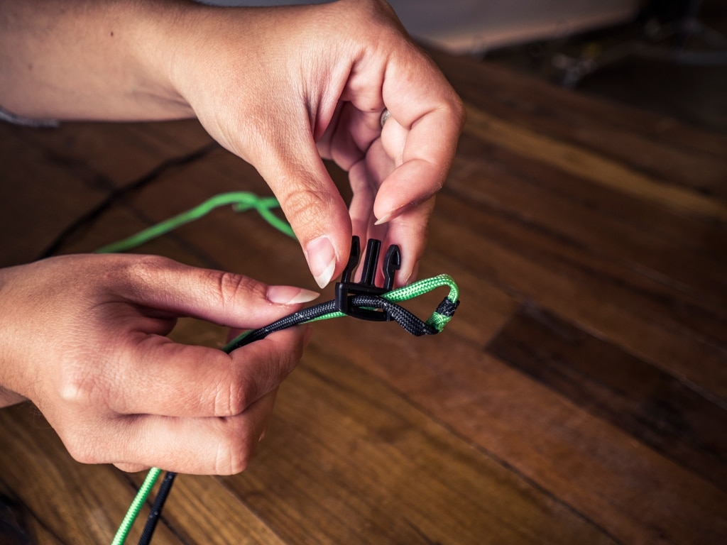
Paracord Survival Bracelet Directions
Attach paracord to one of the buckle ends (either buckle piece works) using a girth hitch.
Here’s how:
Find the center of the full length of cord by holding the loose ends together and pinching the loop at the other end.
Thread the loop through one side of the buckle so it sticks out an inch or so.
Thread the loose ends through the loop and pull the cord snug against the buckle.

Slide 10
Paracord Survival Bracelet Directions
Determine bracelet length
Thread the dangling free ends of the cord through the other buckle piece.
Measuring from one buckle to the other (excluding the male prongs), position the free buckle so the bracelet length equals your wrist measurement plus one inch.
Our initial length was 7.5 in., so we wanted our bracelet to be 8.5 in. long.
This gives a comfortable fit.

Slide 11
Paracord Survival Bracelet Directions
Weave the main bracelet
Now you will weave the body of the bracelet using cobra stitch.
It helps to secure the buckle with the free ends to your work surface with a piece of tape so it doesn’t move around while you’re braiding (not shown).
Pick up the left-hand cord and thread it behind the center strands. Cross it over the top of the right-hand cord.

Slide 12
Paracord Survival Bracelet Directions
Pick up the right-hand cord and cross it over the center strands, then through the loop created by the left-hand cord.

Slide 13
Paracord Survival Bracelet Directions
Snug the cords tight.

Slide 14
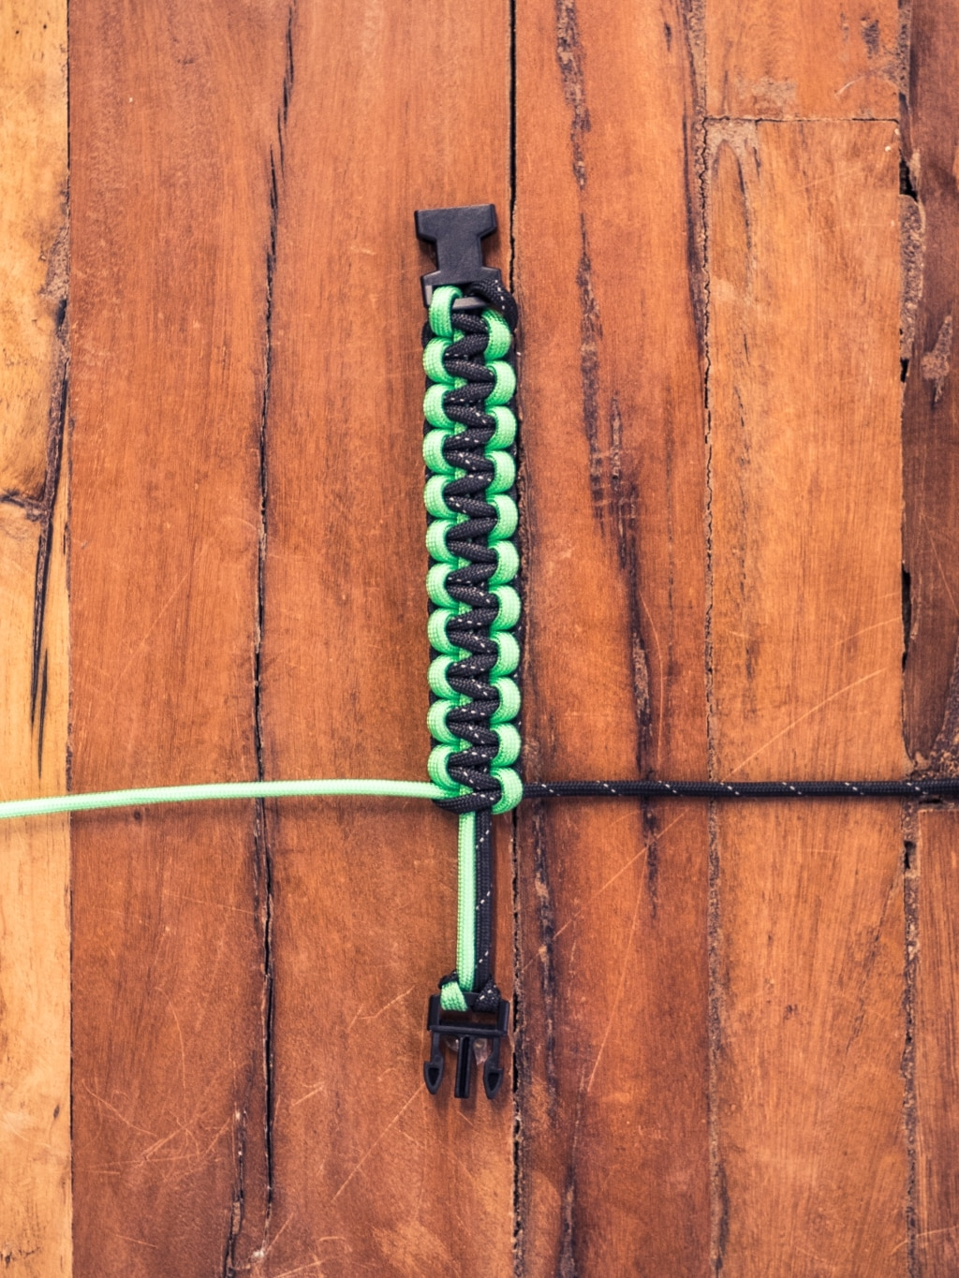
Paracord Survival Bracelet Directions
Repeat the weave, alternating sides, until you reach the other buckle.
You will be able to tell if you forgot to alternate because the braid will start to rotate.
Simply undo the last knot and continue.

Slide 15
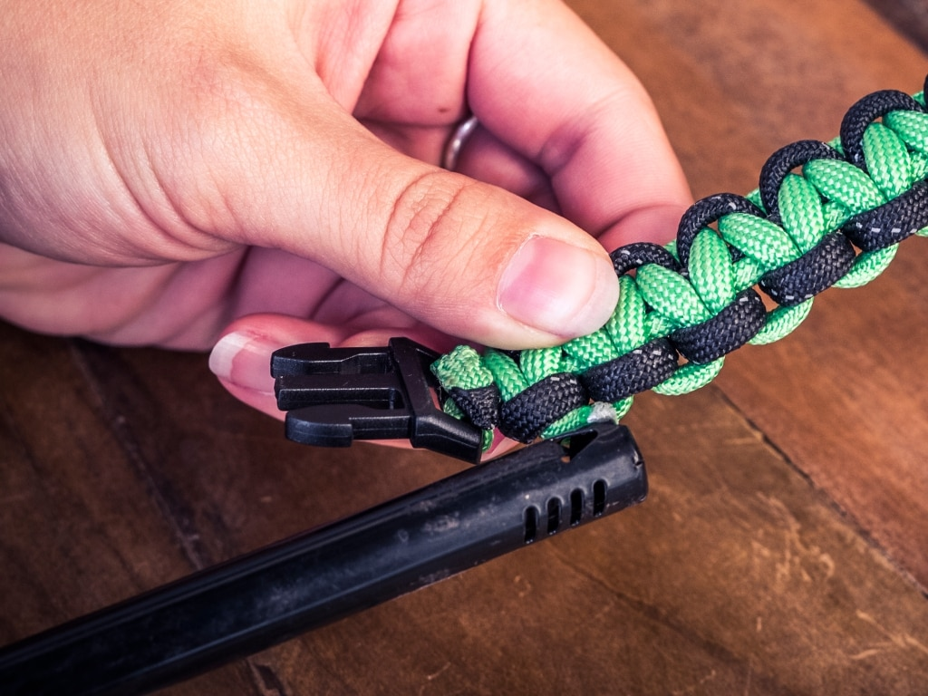
Paracord Survival Bracelet Directions
Once you’ve completed the body of the bracelet, trim the ends of the extra cord to about half an inch.
Burn the trimmed ends and press them to the bracelet cords to “glue” them in place. (Use the end of the lighter or pliers so you don’t burn your fingers).

Slide 16
Paracord Survival Bracelet Directions
Wear your completed bracelet with pride!
You’ll be prepared if you have to secure an emergency tarp or sew a torn garment on your next adventure.
Simply pull or cut the secured ends and unweave until you have the amount of cord you need.

Slide 17
Paracord Survival Bracelet Directions
Now that you know the cobra weave, you can make more bracelets or other fun gifts for all the adventurous people in your life.
If you want even more paracord goodness, check out these DIY Easy Paracord Projects.

